Slide 1
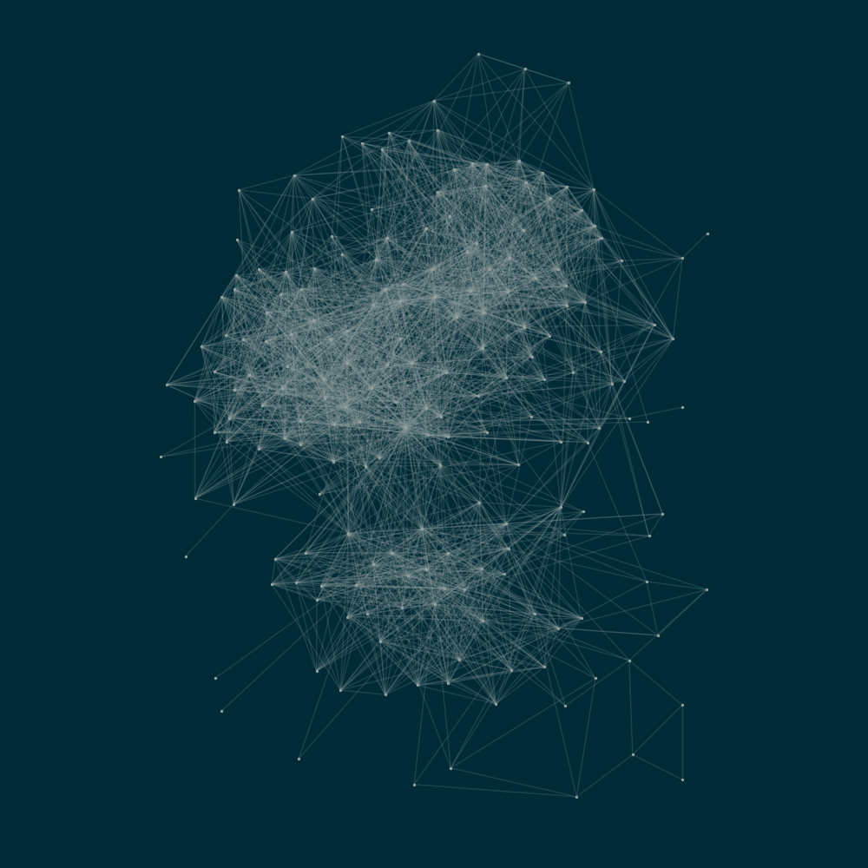
Connectivity in networks
Master thesis presentation
Benoît Richard
under the supervision of
Guyuan Shi
and Prof. Yi-Cheng Zhang

Slide 2
Network
Node
(or vertex)

Slide 3
Network

Slide 4
Network

Slide 5
Network
Edges

Slide 6

Western US power grid

Slide 7
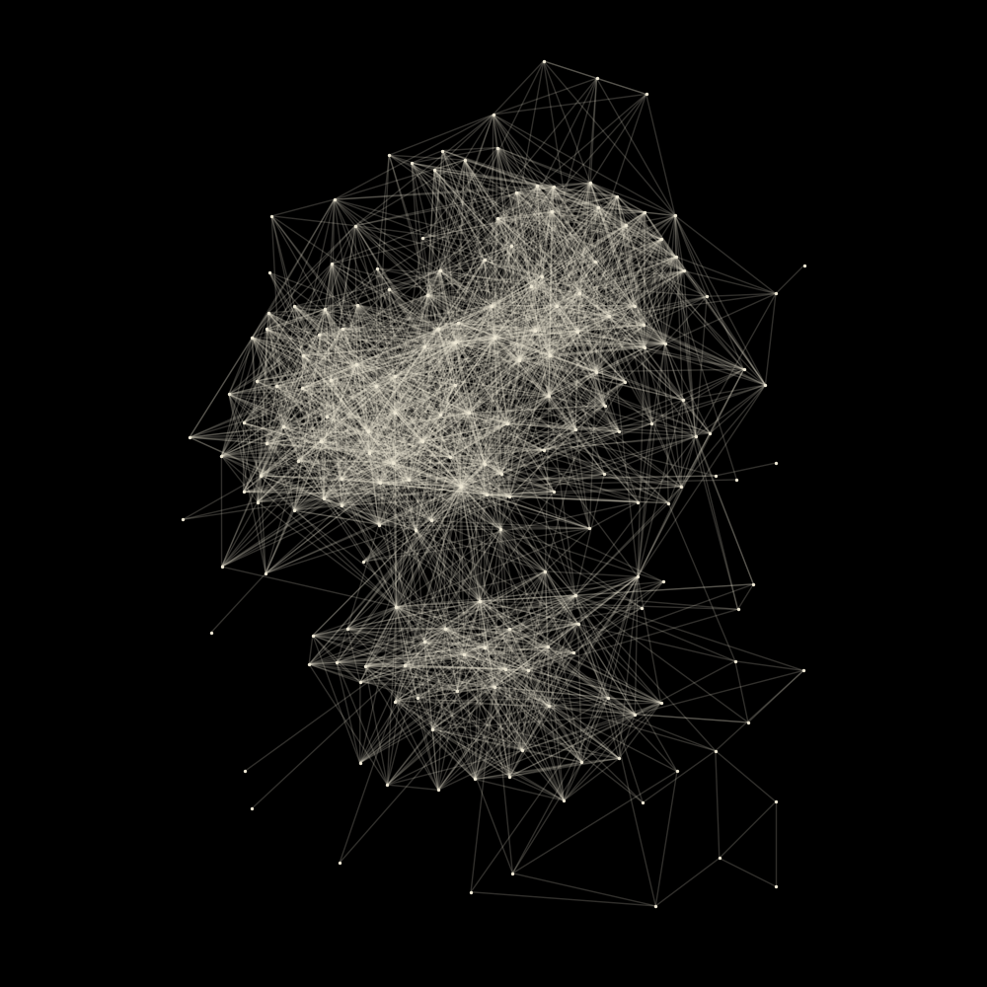
Jazz musicians

Slide 8

E-road
Connected component

Slide 9
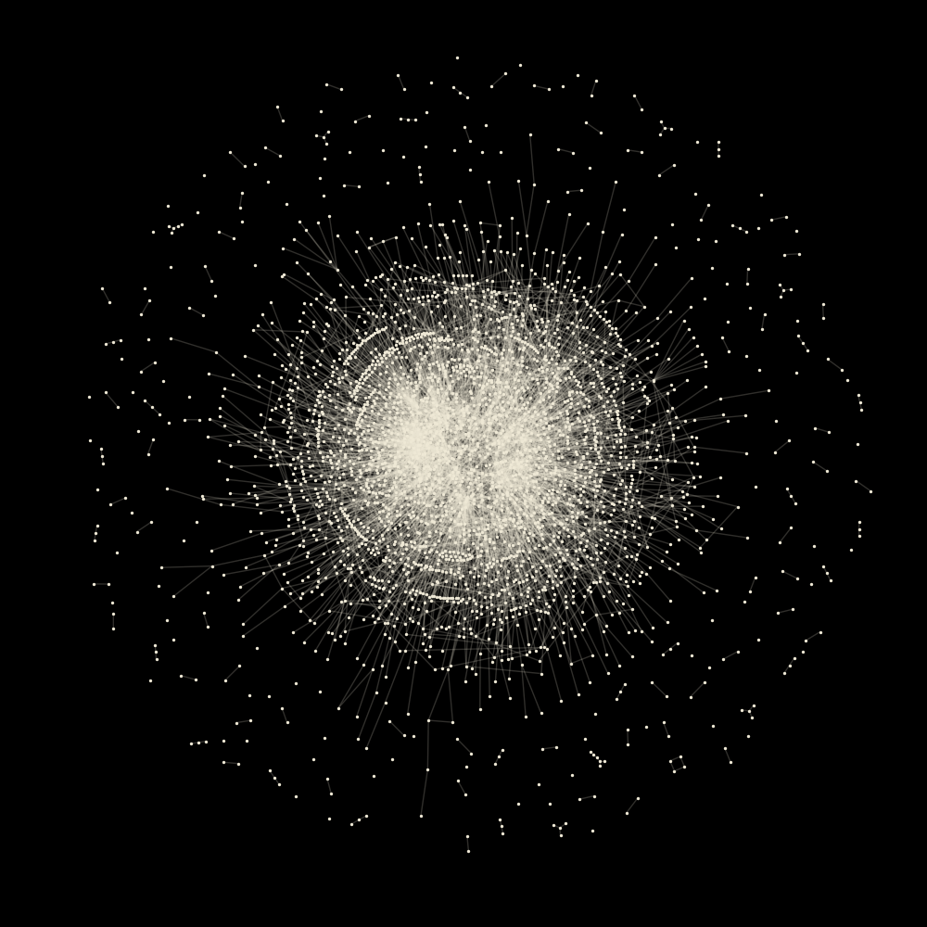
Protein interaction

Slide 10
Configuration model

Slide 11
Configuration model

Slide 12
Configuration model
3
3
1
3
1
1
2
Degree sequence

Slide 13
Configuration model
Degree sequence

Slide 14
Configuration model
Random matching

Slide 15
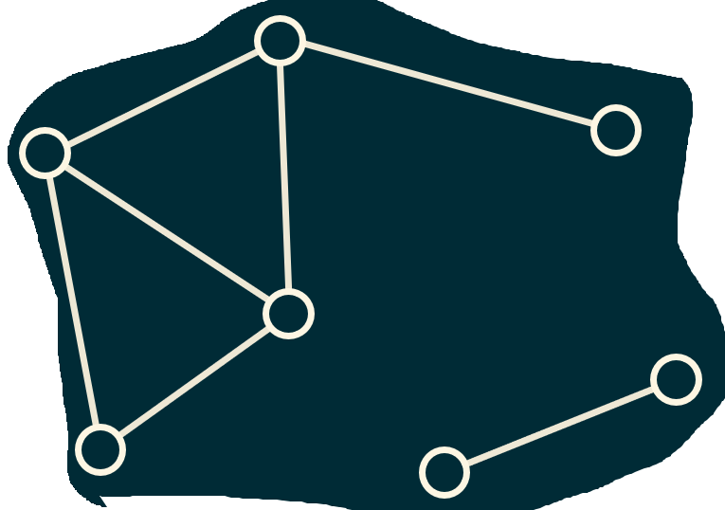
Configuration model
Random matching

Slide 16
Configuration model
Random matching

Slide 17
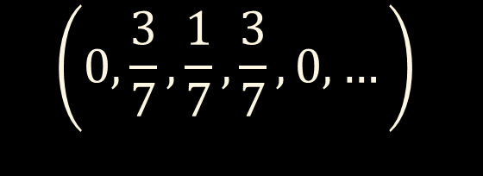

Configuration model
Degree sequence
3, 3, 3, 3, 3, 3, 2, 2, 1, 1, 1, 1, 1, 1
3, 3, 3, 2, 1, 1, 1
$$\left(0,\frac{3}{7},\frac{1}{7},\frac{3}{7}, 0, …\right)$$
Degree distribution $p_{k}$

Slide 18
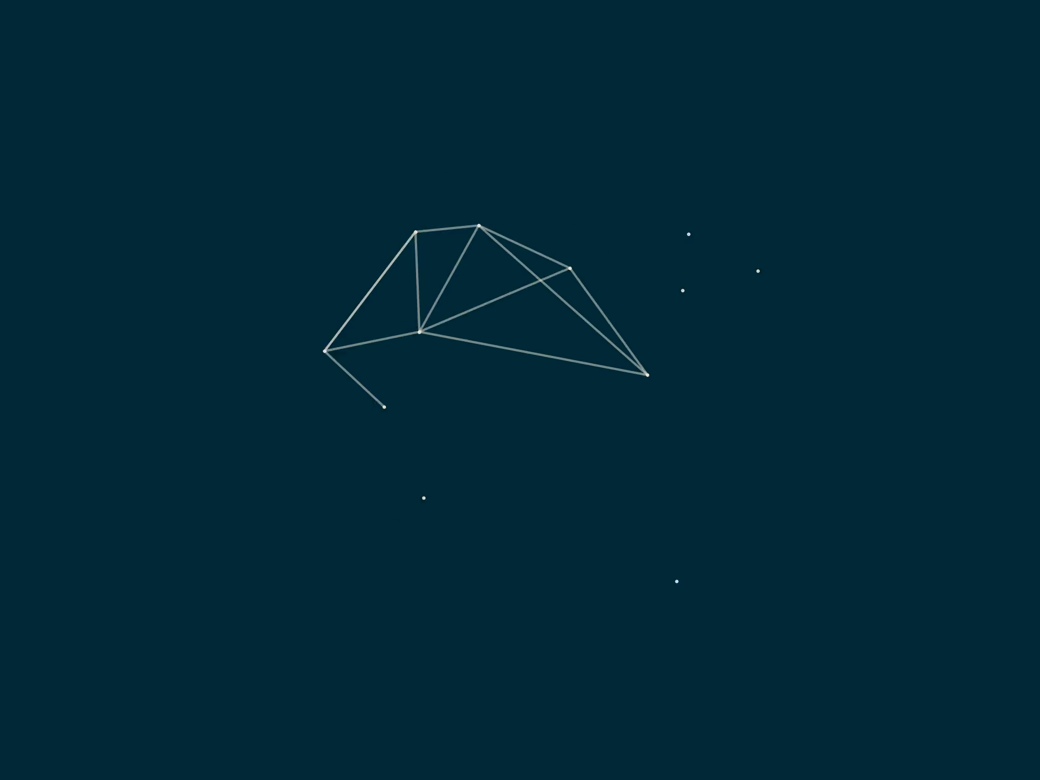




Large $n$ limit
Giant connected component (GCC)
Fraction $S$ of the network
Choose $p_{k}$
Keep $p_{k}$ constant and let $n →∞$
Finite size components

Slide 19
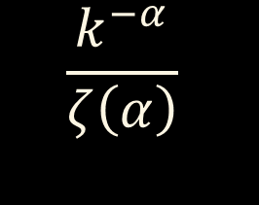
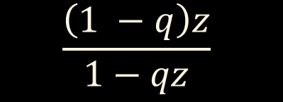
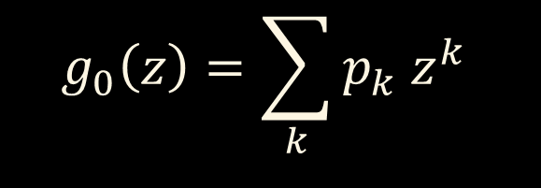
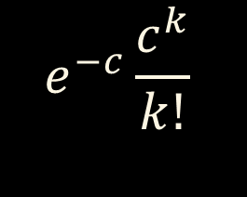
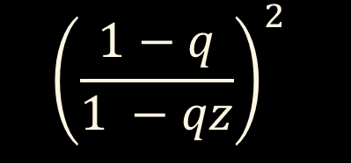


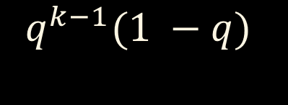

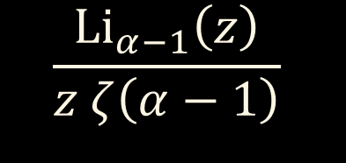
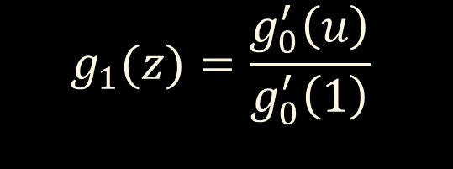
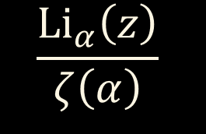

GCC relative size $S$
Degree distribution
Generating functions
$$g_{0}\left(z\right)=\sum_{k}{p_{k} z^{k}}$$
$$g_{1}(z)=\frac{g_{0}^{′}\left(u\right)}{g_{0}^{′}\left(1\right)}$$
$$p_{k}$$
$$e^{−c}\frac{c^{k}}{k!}$$
$$e^{c\left(z −1\right)}$$
$$e^{c\left(z −1\right)}$$
$${\left(\frac{1−q}{1 −qz}\right)}^{2}$$
$$q^{k−1}(1 −q)$$
$$\frac{\left(1 −q\right)z}{1−qz}$$
$$\frac{k^{−α}}{ζ\left(α\right)}$$
$$\frac{Li_{α}\left(z\right)}{ζ\left(α\right)}$$
$$\frac{Li_{α−1}\left(z\right)}{z ζ\left(α−1\right)}$$

Slide 20



GCC relative size $S$
$$g_{0}\left(z\right)=\sum_{k}{p_{k} z^{k}}$$
$$g_{1}(z)=\frac{g_{0}^{′}\left(u\right)}{g_{0}^{′}\left(1\right)}$$
$u=g_{1}(u)$
$$S=1 −g_{0}\left(u\right)$$

Slide 21
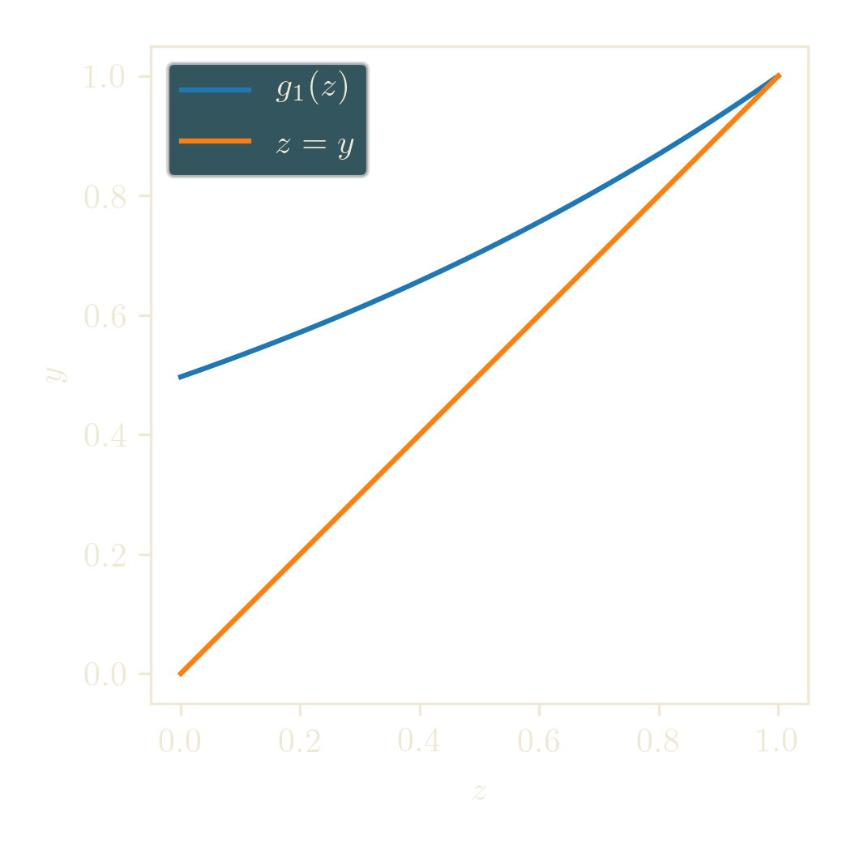
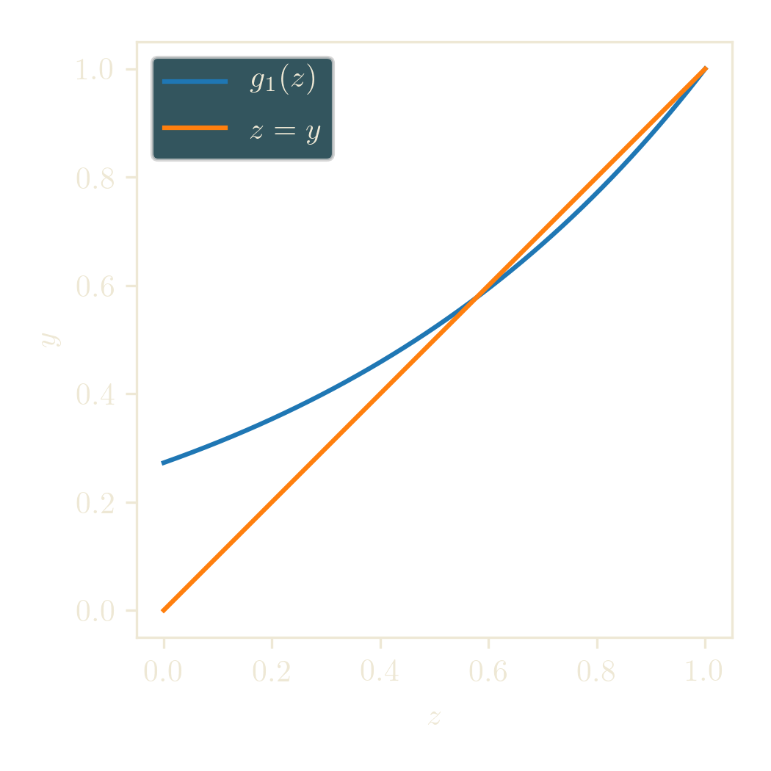
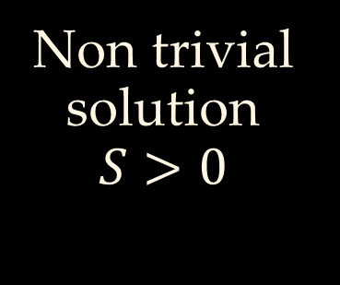
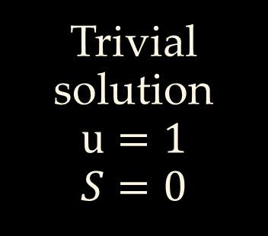

GCC relative size $S$
Fixpoint equation
$u=g_{1}(u)$
$$S=1 −g_{0}\left(u\right)$$
Trivial solution
$$u=1$$
$$S=0$$
Non trivial solution
$$S>0$$

Slide 22
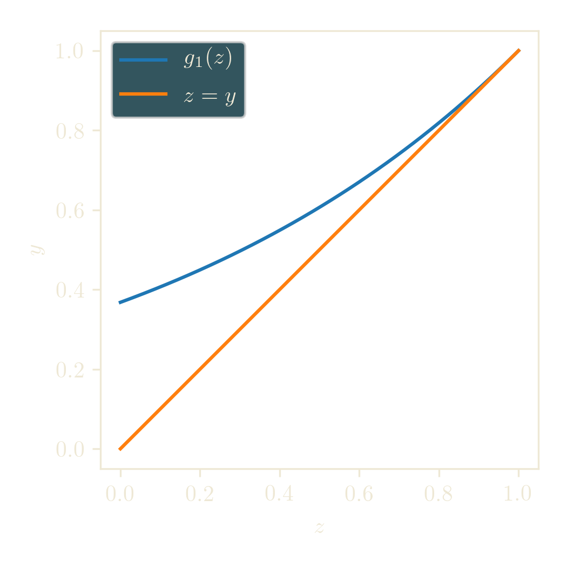


GCC relative size $S$
Curves are tangent
Critical point $ℛ$
$$g_{1}^{′}\left(1\right)=1$$

Slide 23
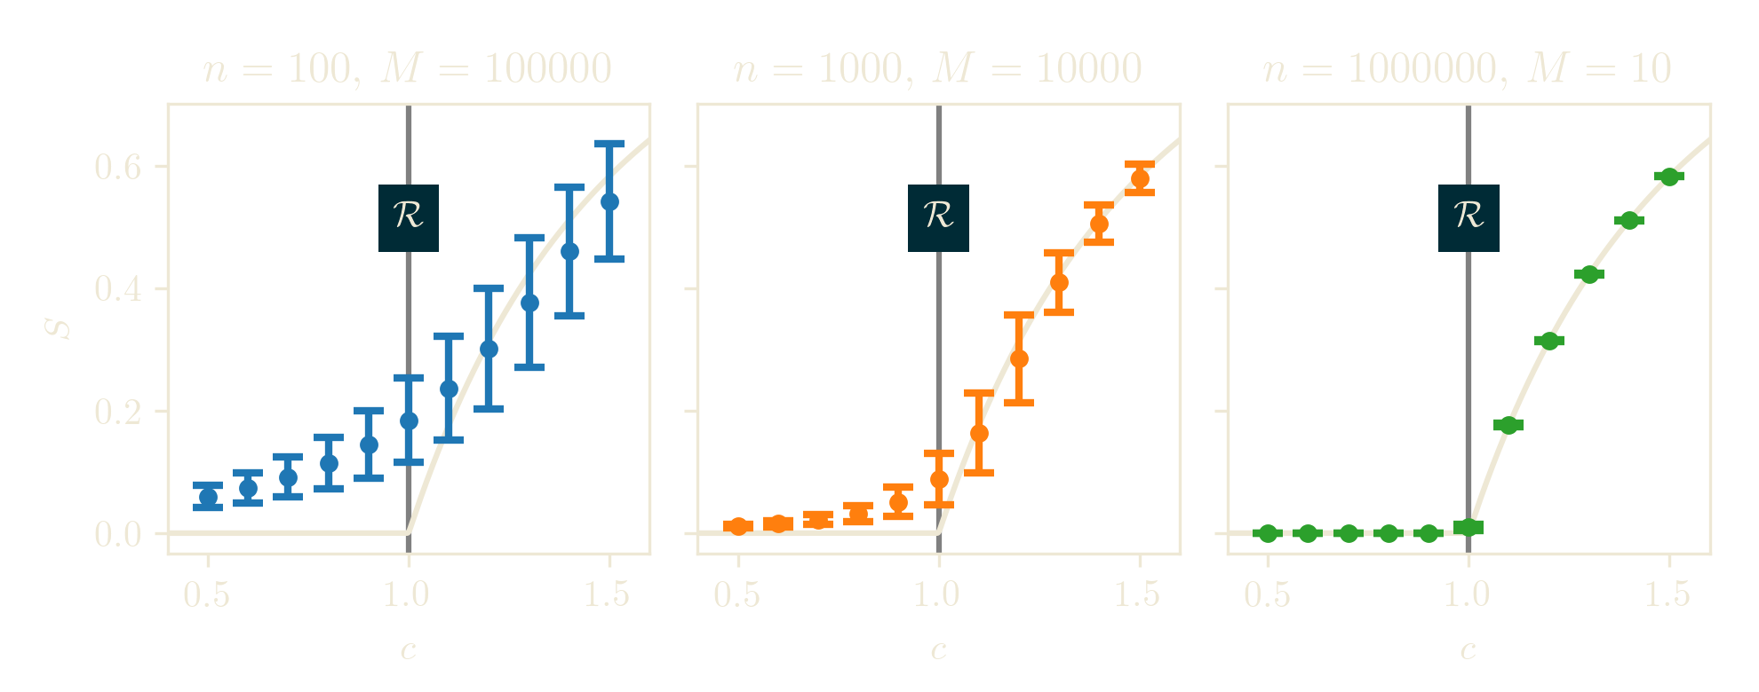
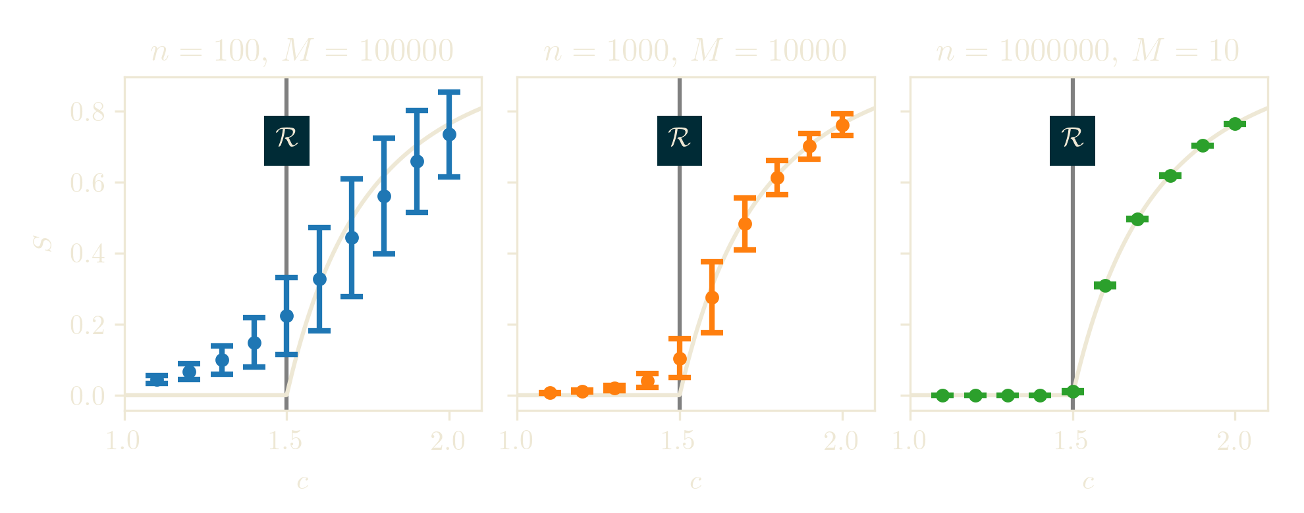
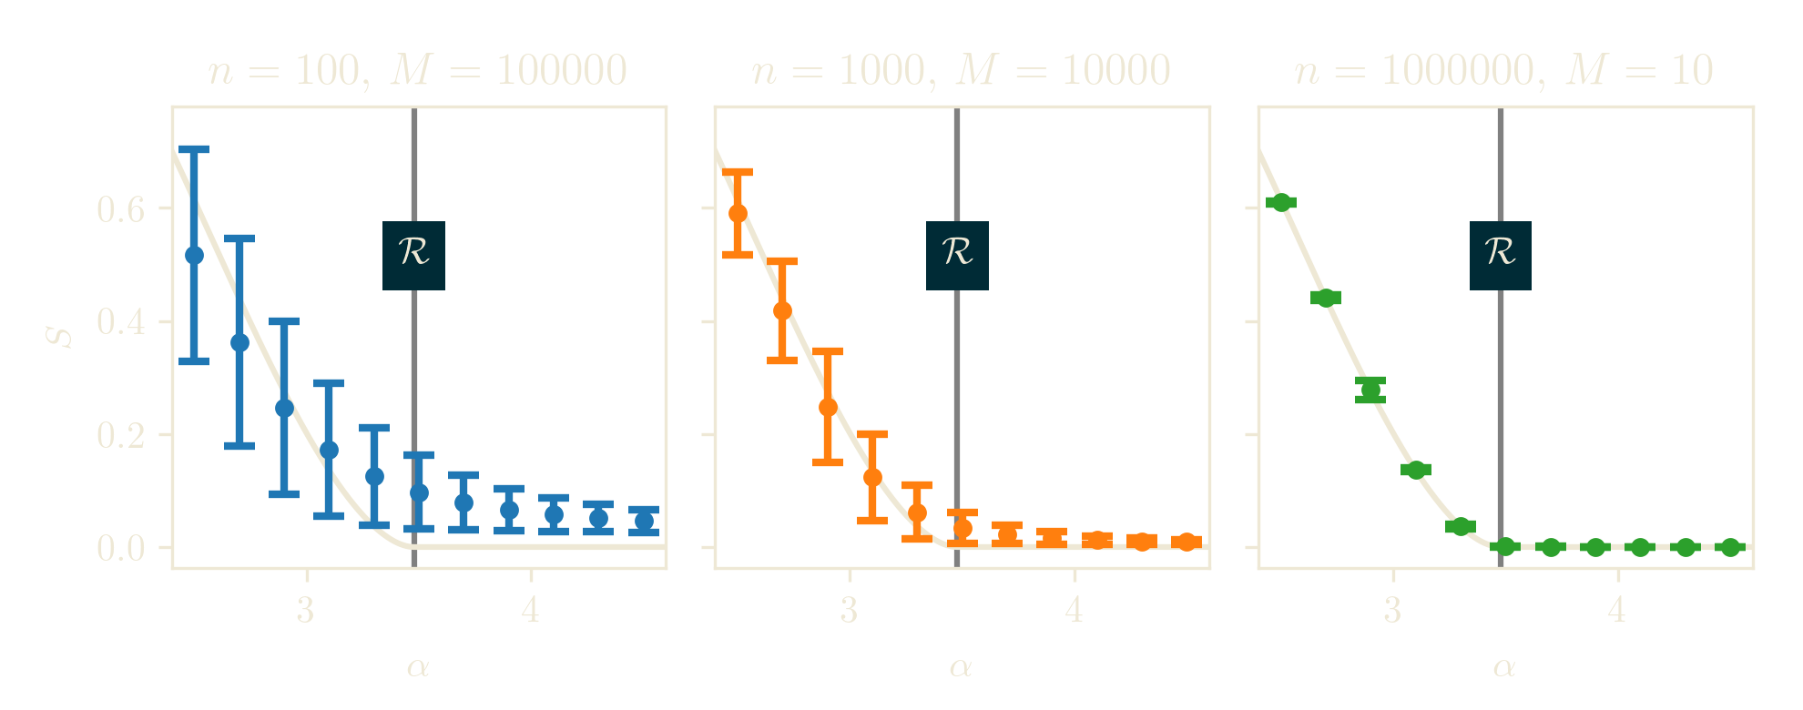
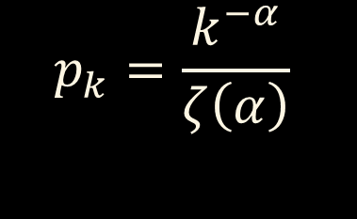
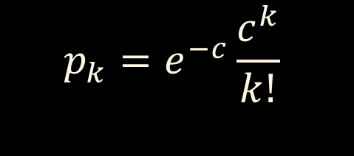

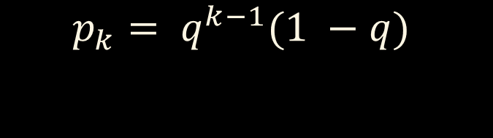
$$p_{k}=e^{−c}\frac{c^{k}}{k!}$$
$$p_{k}= q^{k−1}(1 −q)$$
$$c={\left(1 −q\right)}^{−1}$$
$$p_{k}=\frac{k^{−α}}{ζ\left(α\right)}$$

Slide 24
Multiplex network
B
C
A
D
F
E
G

Slide 25
Multiplex network
B
C
A
Layer 1
D
F
E
G

Slide 26
Multiplex network
B
C
A
Layer 2
D
F
B
E
G
C
A
Layer 1
D
F
E
G

Slide 27




Multiplex network
…
…
$$g_{0}^{(i)}\left(z\right)$$
B
C
A
Layer $i$
$$p_{k}^{(i)}$$
D
$$g_{1}^{(i)}(z)$$
F
B
E
…
G
C
A
D
F
B
E
G
C
A
Layer 2
D
F
B
E
G
C
A
Layer 1
D
F
E
G

Slide 28
Viable cluster
Layer 1
Layer 2
B
B
C
C
C
C
A
A
D
D
B
B
F
F
E
E
G
G
E
D
E
D

Slide 29
Viable cluster
Viable = connected in each layer
B
B
C
C
C
C
A
A
D
D
B
B
F
F
E
E
G
G
E
E
D
D

Slide 30


Viable component
Viable = connected in each layer
B
B
Fraction $S$ in the large $n$ limit
C
C
C
C
A
A
D
D
B
B
$⇒$ Giant Viable Cluster (GVC)
F
F
E
E
G
G
E
E
D
D
Viable components are much smaller

Slide 31

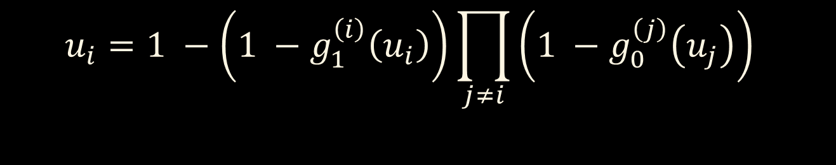
Giant Viable Component size S
Fixpoint equation
$u=g_{1}(u)$
Single layer
$$S=1 −g_{0}\left(u\right)$$
$$u_{i}=1 −\left(1 −g_{1}^{\left(i\right)}\left(u_{i}\right)\right)\prod_{j≠i}{\left(1 −g_{0}^{\left(j\right)}\left(u_{j}\right)\right) }$$
$$S=\prod_{i}{\left(1 −g_{0}^{\left(i\right)}\left(u_{i}\right)\right) }$$

Slide 32

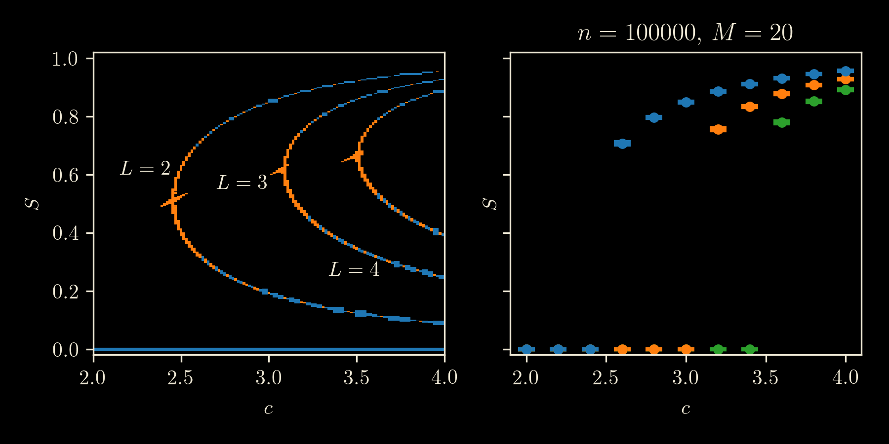
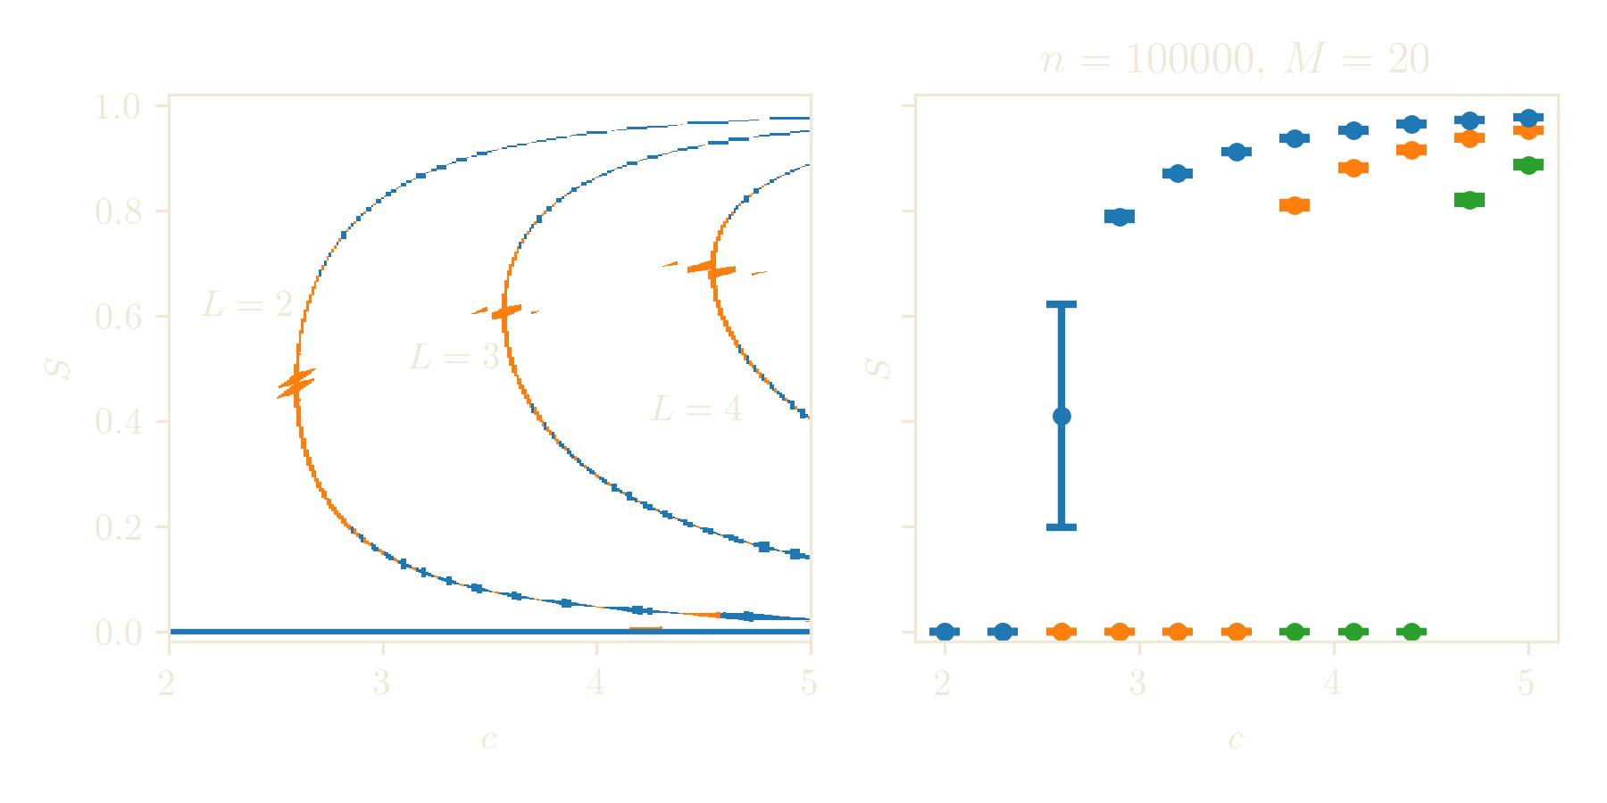

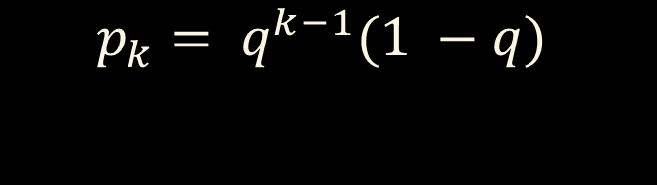

Giant Viable Component size S
$$p_{k}=e^{−c}\frac{c^{k}}{k!}$$
$$p_{k}= q^{k−1}(1 −q)$$
$$c={\left(1 −q\right)}^{−1}$$

Slide 33
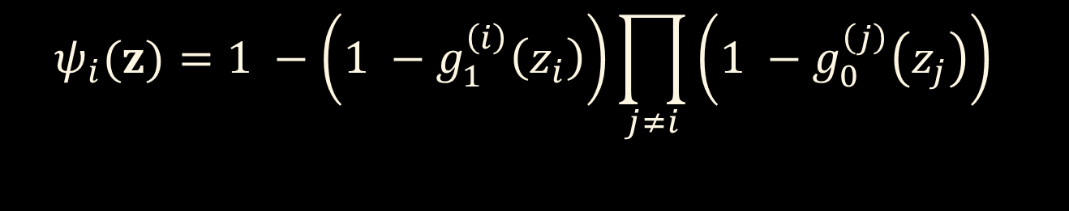
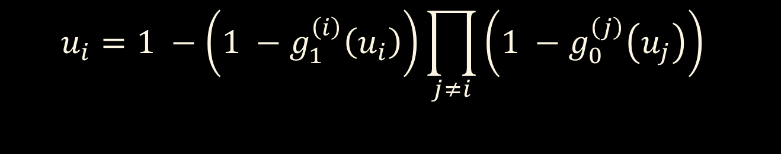

Fixpoint equation
$$u_{i}=1 −\left(1 −g_{1}^{\left(i\right)}\left(u_{i}\right)\right)\prod_{j≠i}{\left(1 −g_{0}^{\left(j\right)}\left(u_{j}\right)\right) }$$
$$ψ_{i}(z)=1 −\left(1 −g_{1}^{\left(i\right)}\left(z_{i}\right)\right)\prod_{j≠i}{\left(1 −g_{0}^{\left(j\right)}\left(z_{j}\right)\right) }$$
$$ψ\left(z\right)=\left(ψ_{1}\left(z\right),ψ_{2}\left(z\right), …,ψ_{L}\left(z\right)\right)$$
$$u=ψ\left(u\right)$$
$u=(u_{1}, u_{2}, …, u_{L})$

Slide 34


Validated numerics
$$ψ :ℝ^{L} →ℝ^{L}$$
Fixpoint equation $u=ψ(u)$
$$A$$
B
A

Slide 35

Validated numerics
$$ψ :ℝ^{L} →ℝ^{L}$$
Fixpoint equation $u=ψ(u)$
$$A$$
B
A
$$ψ(A)$$

Slide 36













Validated numerics
$$ψ :ℝ^{L} →ℝ^{L}$$
$Ψ\left(A\right)$ includes numerical errors
Fixpoint equation $u=ψ(u)$
$$A$$
$$A$$
AA
B
$$ψ(A)$$
$$ψ(A)$$
A
A
$$Ψ(A)$$
$$Ψ(A)$$
$$Ψ(A)$$
$$Ψ(A)$$
$$ψ\left(A\right)∩A=∅$$
$$ψ\left(A\right)⊂A$$
$⇒$No solution
$⇒$Solution exists
(By Schauder fixpoint theorem)

Slide 37




Validated numerics
$$ψ :ℝ^{L} →ℝ^{L}$$
$Ψ\left(A\right)$ includes numerical errors
Fixpoint equation $u=ψ(u)$
$$A$$
$$A$$
AA
B
$$ψ(A)$$
$$ψ(A)$$
A
A
$$Ψ(A)$$
$$Ψ(A)$$
$$Ψ(A)$$
$$Ψ(A)$$
$$⊂A$$
$$∩A=∅$$
$⇒$No solution
$⇒$Solution exists
(By Schauder fixpoint theorem)

Slide 38




Critical region
$$u=ψ(u)$$
Residual function
$$f\left(z\right)=ψ\left(z\right)−z$$
Jacobi matrix $J$ of $f(z)$
Phase transition
Critical condition
$$f\left(z\right)=0$$
$$det J=0$$

Slide 39
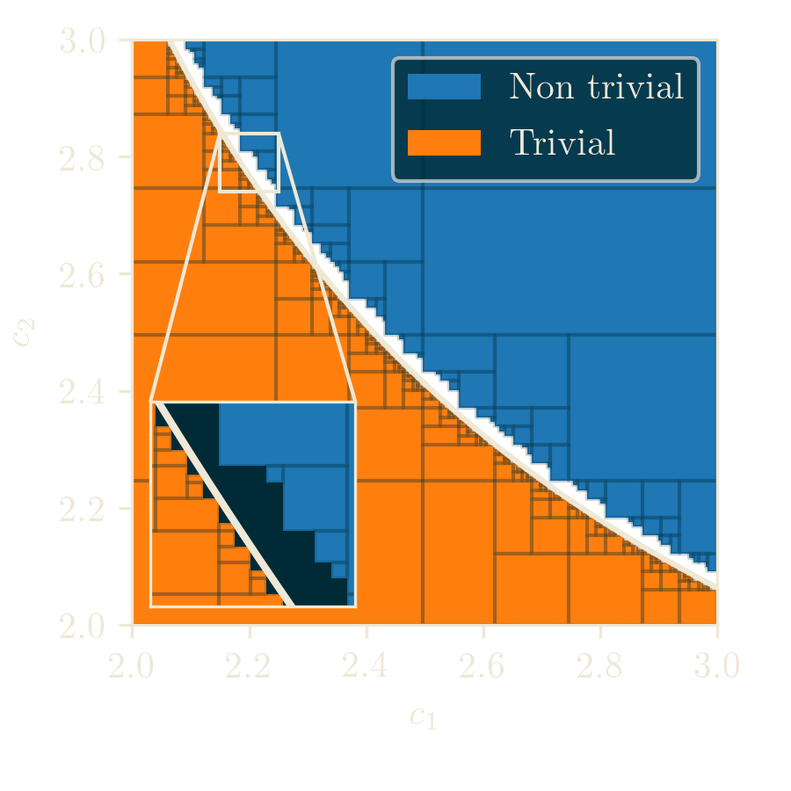
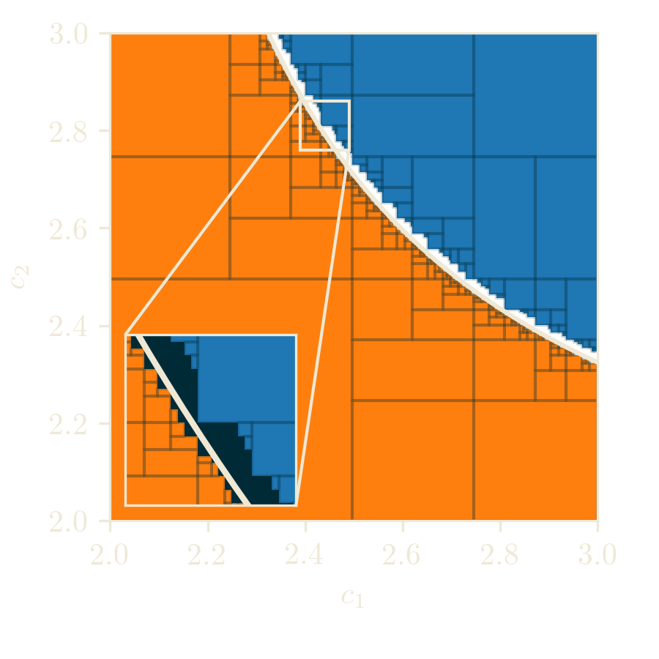

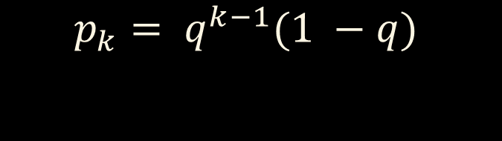
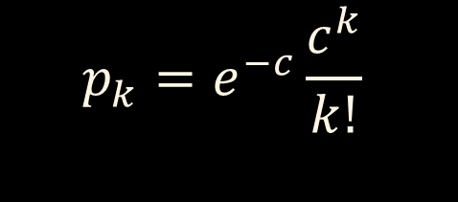
Critical region
$$f\left(z\right)=0$$
$$det J=0$$
$$p_{k}=e^{−c}\frac{c^{k}}{k!}$$
$$p_{k}= q^{k−1}(1 −q)$$

Slide 40
Thank you for your attention

Slide 41
Questions and remarks
? !

